Slide 1

Integrating Virtual Exposure in LIME Low-light Image Enhancement
Ahsan Md Sajid Khan, Yang Gao, Jun Cheng, and He Yan
CPSC5416 - Digital Image Processing & Computer Vision
Submitted to,
Professor Amr Abdel-Dayem
Bharti School of Engineering and Computation
Science, Engineering and Architecture
Date November 16, 2023

Slide 2
Content
Introduction
Background / Literature Review
Project objective
Architecture
Methodologies
Results & Discussions
Acknowledgement
References
Questions and Answer

Slide 3
Introduction
This project introduces an innovative method for enhancing low-light images through a multi-scale fusion strategy. Unlike previous techniques, this approach eliminates the need for image calibration and offers a flexible solution for various lighting conditions. By producing a single high-quality image from multiple frames generated using a quadratic function, we achieve a high level of adaptability. Weight maps based on contrast, saturation, and saliency guide the multi-scale fusion algorithm, minimizing common artifacts. This method outperforms existing algorithms in brightness, detail, and robustness, making it applicable to diverse fields requiring high-quality imaging in challenging lighting conditions.

Slide 4
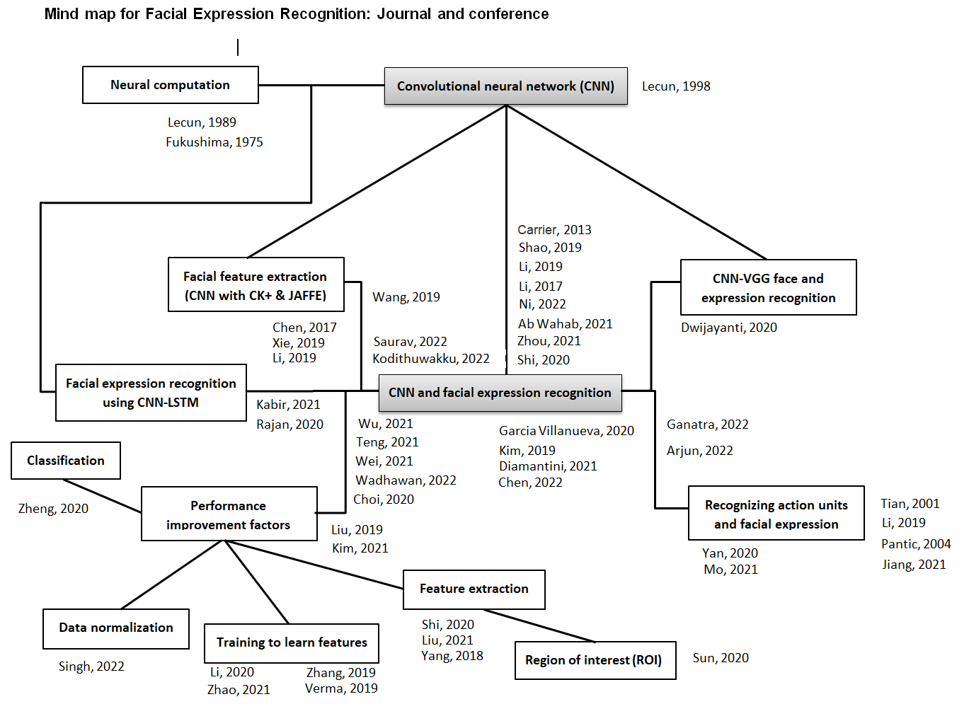
Background and Literature Review

Slide 5
Project Objective
Ggggg
Therefore, ………………..

Slide 6
Architecture/Algorithm
7
48x48
26x26x8
13x13x8
Conv
maxpool
Softmax

Slide 7
Architecture
Input Layer: The input layer is crucial as it defines the shape and format of the input images. In this case, it is designed to take grayscale images of size 48x48 pixels, which is a common format for facial expression recognition tasks.
First and Second Convolutional Blocks (64 and 128 filters): These blocks act as feature extractors, learning low-level features such as edges, corners, and simple textures. By using multiple filters, the model learns various feature representations, which helps in recognizing different facial expressions. Batch normalization accelerates training, while max-pooling and dropout layers help prevent overfitting and reduce spatial dimensions.
Third and Fourth Convolutional Blocks (256 and 512 filters): These blocks learn more complex and high-level features, such as facial parts (eyes, nose, mouth) and their arrangements, which are critical in recognizing facial expressions. Increasing the number of filters allows the model to learn more diverse and intricate features. Batch normalization, max-pooling, and dropout layers continue to improve the model's performance and generalization.

Slide 8
Architecture
AveragePooling2D Layer: The average pooling layer condenses the spatial information from the last convolutional block, ensuring that the most important features are retained while reducing computational complexity.
Fully Connected Layers: These layers act as the "decision-making" part of the neural network. The Flatten layer converts the output of the last pooling layer into a one-dimensional vector, which is then passed to the Dense layers. The first Dense layer (512 units) learns the relationships between the extracted features, while the output Dense layer (with 'num_classes' units) predicts the facial expression probabilities using softmax activation.

Slide 9
Methodologies

Slide 10
Methodologies
Steps,
Data preparation: CK+ extended a dataset of labeled facial images that correspond to different facial expressions, such as happiness, sadness, anger, and surprise. Reshape (48x48x1) and split the dataset into training (80%) and testing (20%) datasets.
Input preprocessing: Normalize the image and turn the level in categorical facial expression 0: 'Anger', 1: 'Disgust', 2: 'Fear', 3: 'Happy', 4: 'Sadness', 5: 'Surprise', 6: 'Neutral‘, 7: ‘Contempt’
Define the CNN architecture and train the model: Create a CNN architecture that includes Conv2D layers, pooling layers, and fully connected layers. Train the CNN model on the training dataset (80%). The model learns to recognize patterns and features in the facial images that correspond to different facial expressions.

Slide 11
Methodologies
Steps,
Define the CNN architecture and train the model:
We have use following functions and hyper-parameters
Learning rate = 0.001
Conv2D: A 2D convolution layer with 64 filters, each of size 3x3, using ReLU activation function and He normal weight initialization. The input shape is 48x48 gray-scale images with 1 channel. Padding is set to 'same' to keep the output size same as the input size.
Batch-Normalization: Normalizes the activations of the previous layer, helping in faster convergence and better generalization.
Max-pooling layer, flattened and fully connected layer
Train the model: Train the CNN model on the training dataset using sequential batch execution.

Slide 12
Architecture

Slide 13
Results and Discussions

Slide 14
Results and Discussions

Slide 15
Acknowledgement

Slide 16
References

Slide 17
Question ?

Slide 18
Thank You

